Slide 1
Course : Computational Biology
Effective Period : June 2022
DNA Composition Analysis Session 2

Slide 2
Objective and Outline
LO : Execute a planned simulation of Introduction to BioPython, DNA Sequence Analysis, and DNA Sequence Alignment
In this course we will be simulating basic Bioinformatics analysis using Biopython. Although the Python part is dominant, this course is still ideal for students only with a basic knowledge of biology. The course contains a basic introduction to the Jupyter Notebook and Colab Environment,
In this session, we will start exploring a simulation concept using Open-Source Biopython
Official Website : https://biopython.org/
Outline
GC and AT Composition on DNA
Melting Point of DNA
Nucleotide Molecular Weight

Slide 3
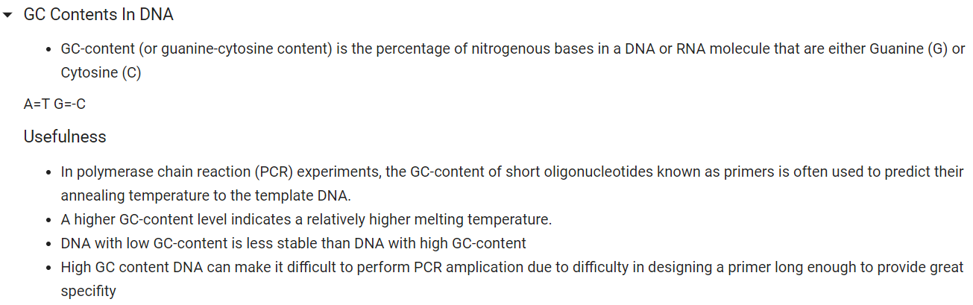
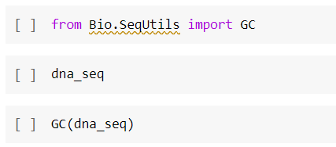
GC and AT Composition of DNA

Slide 4
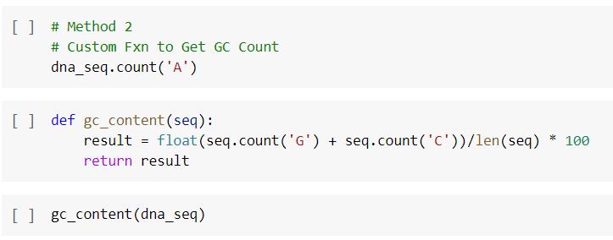
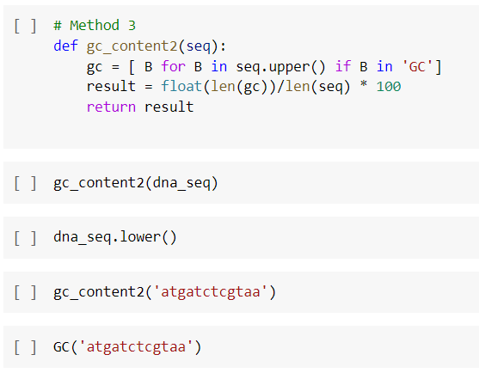
GC and AT Composition of DNA

Slide 5
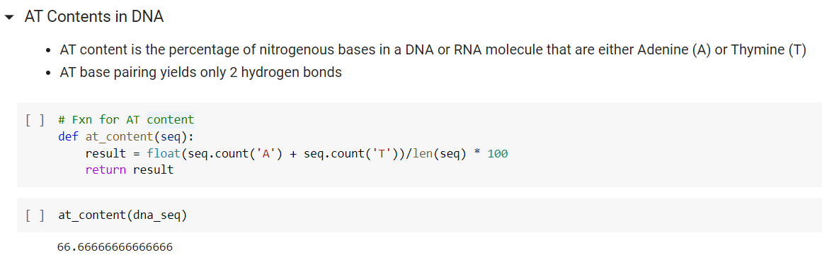
GC and AT Composition of DNA

Slide 6
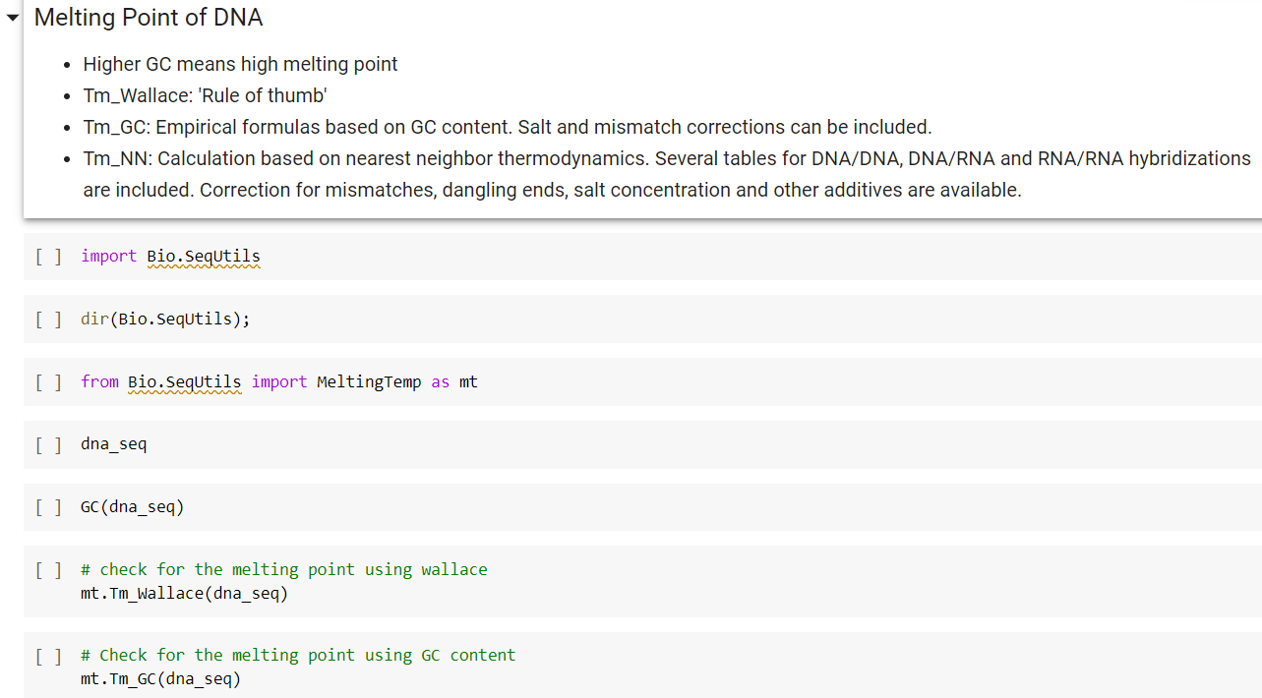
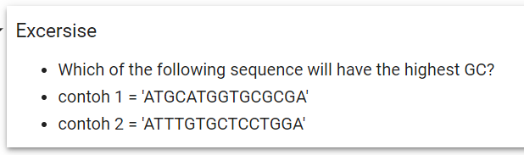
Melting Point of DNA

Slide 7
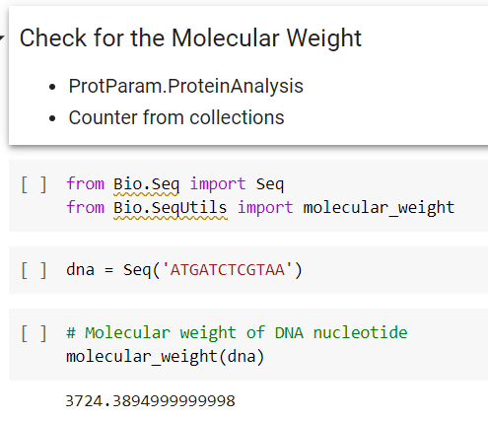
Nucleotide Molecular Weight

Slide 8
Exercise
Given 2 sequences :
Seq 1 = 'ATGCATGGTGCGCGA’
Seq 2 = 'ATTTGTGCTCCTGGA’
Which of the sequence will have the highest GC ?
Which of the sequence will have higher melting temperature
Which of the sequence will have the highest Molecular Weight ?

